Slide 1
Code Slayer
Tic Tac Toe Game
By Elvis, Axay, Luis, Stephanie, Nick

Slide 2
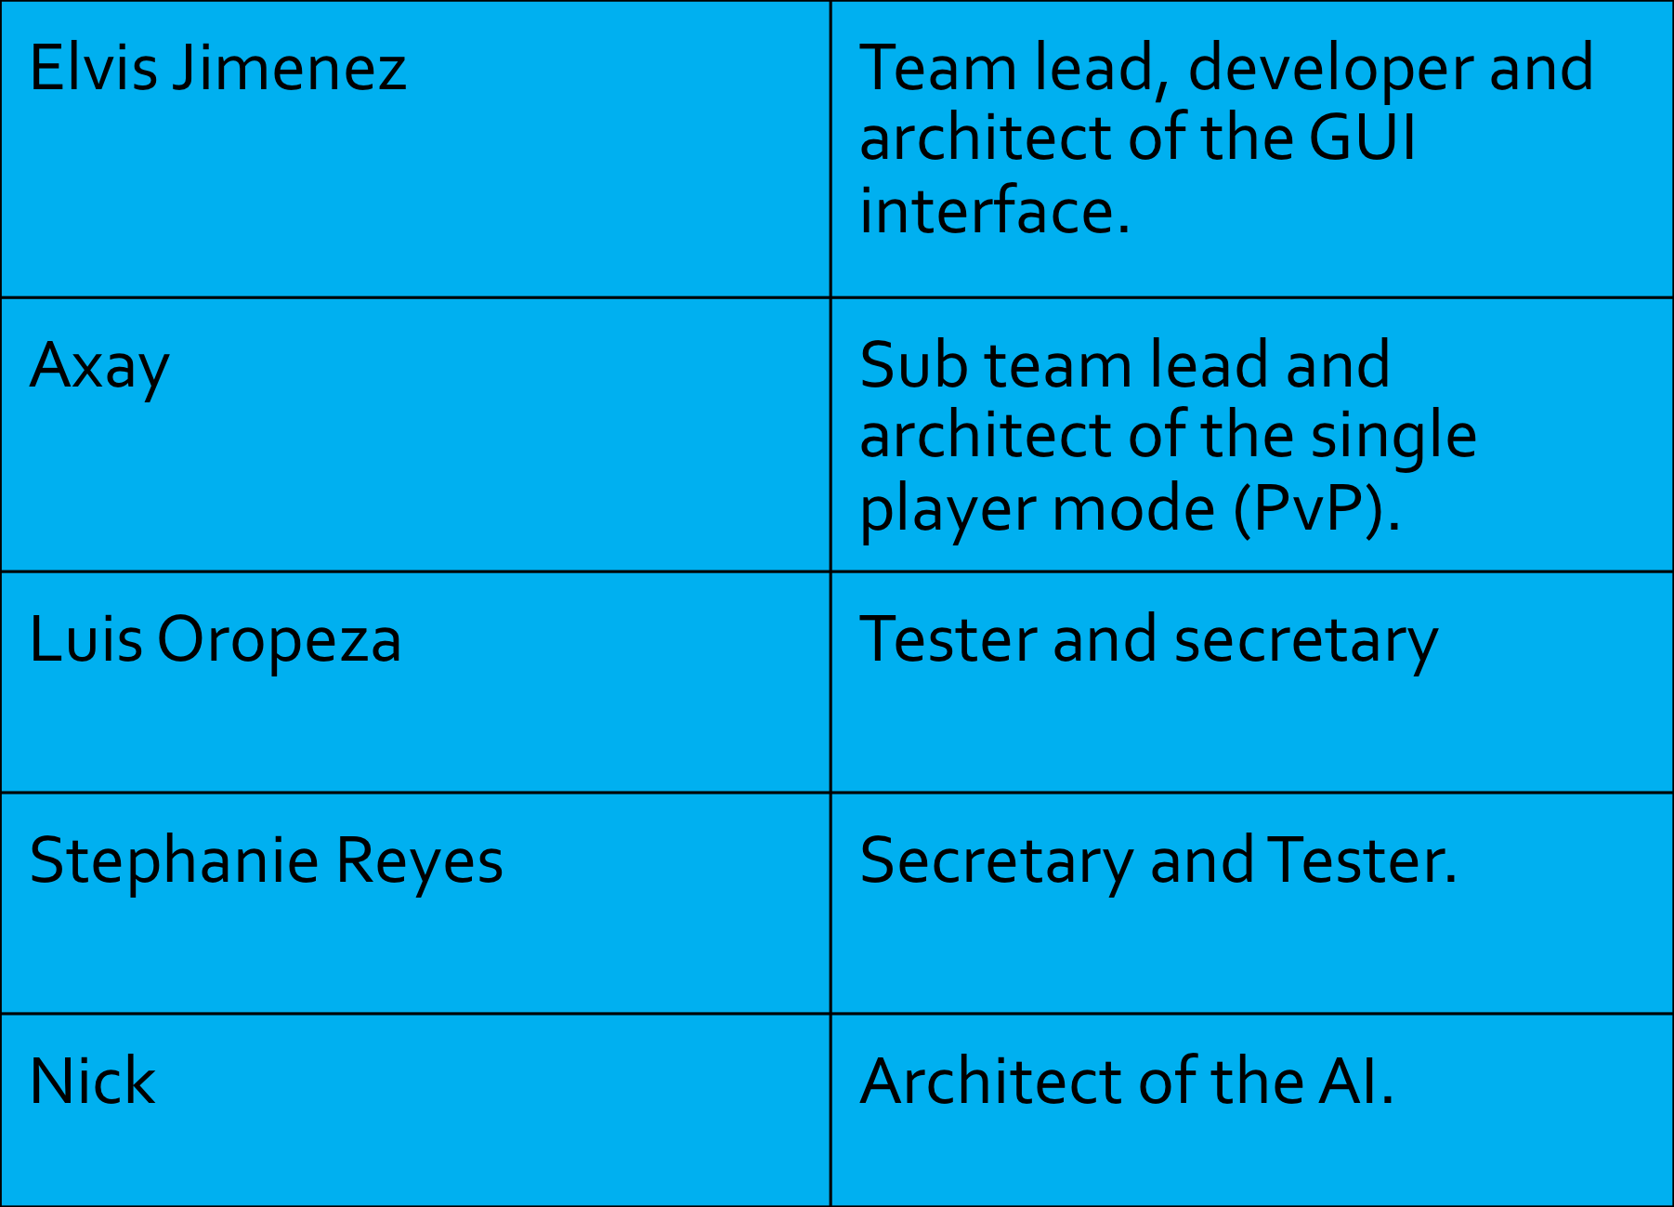
Role of each member

Slide 3
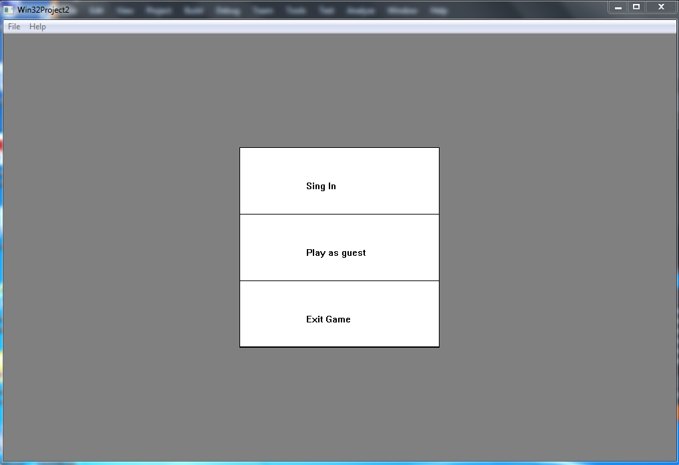
USER LOGIN/ SIGN UP

Slide 4
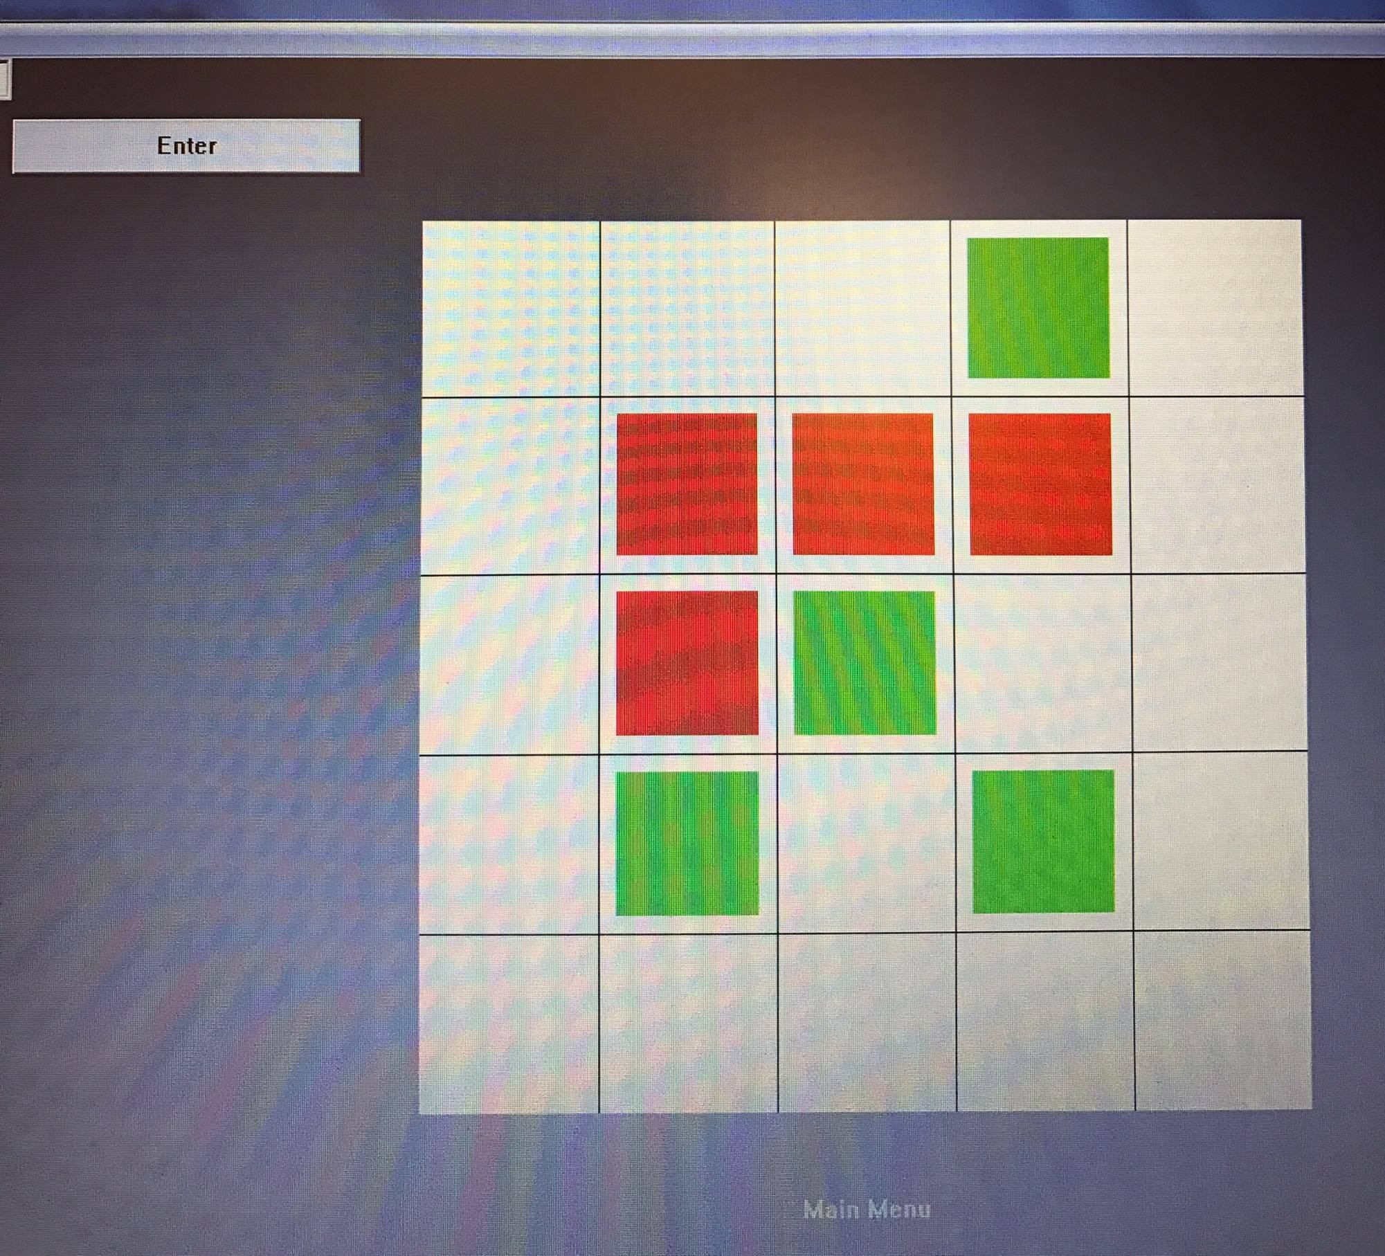
User Interface

Slide 5
Player Option
NEW GAME
PLAYER VS PLAYER
PLAYER VS AI
SELECT MODEL
SCORE
QUIT

Slide 6
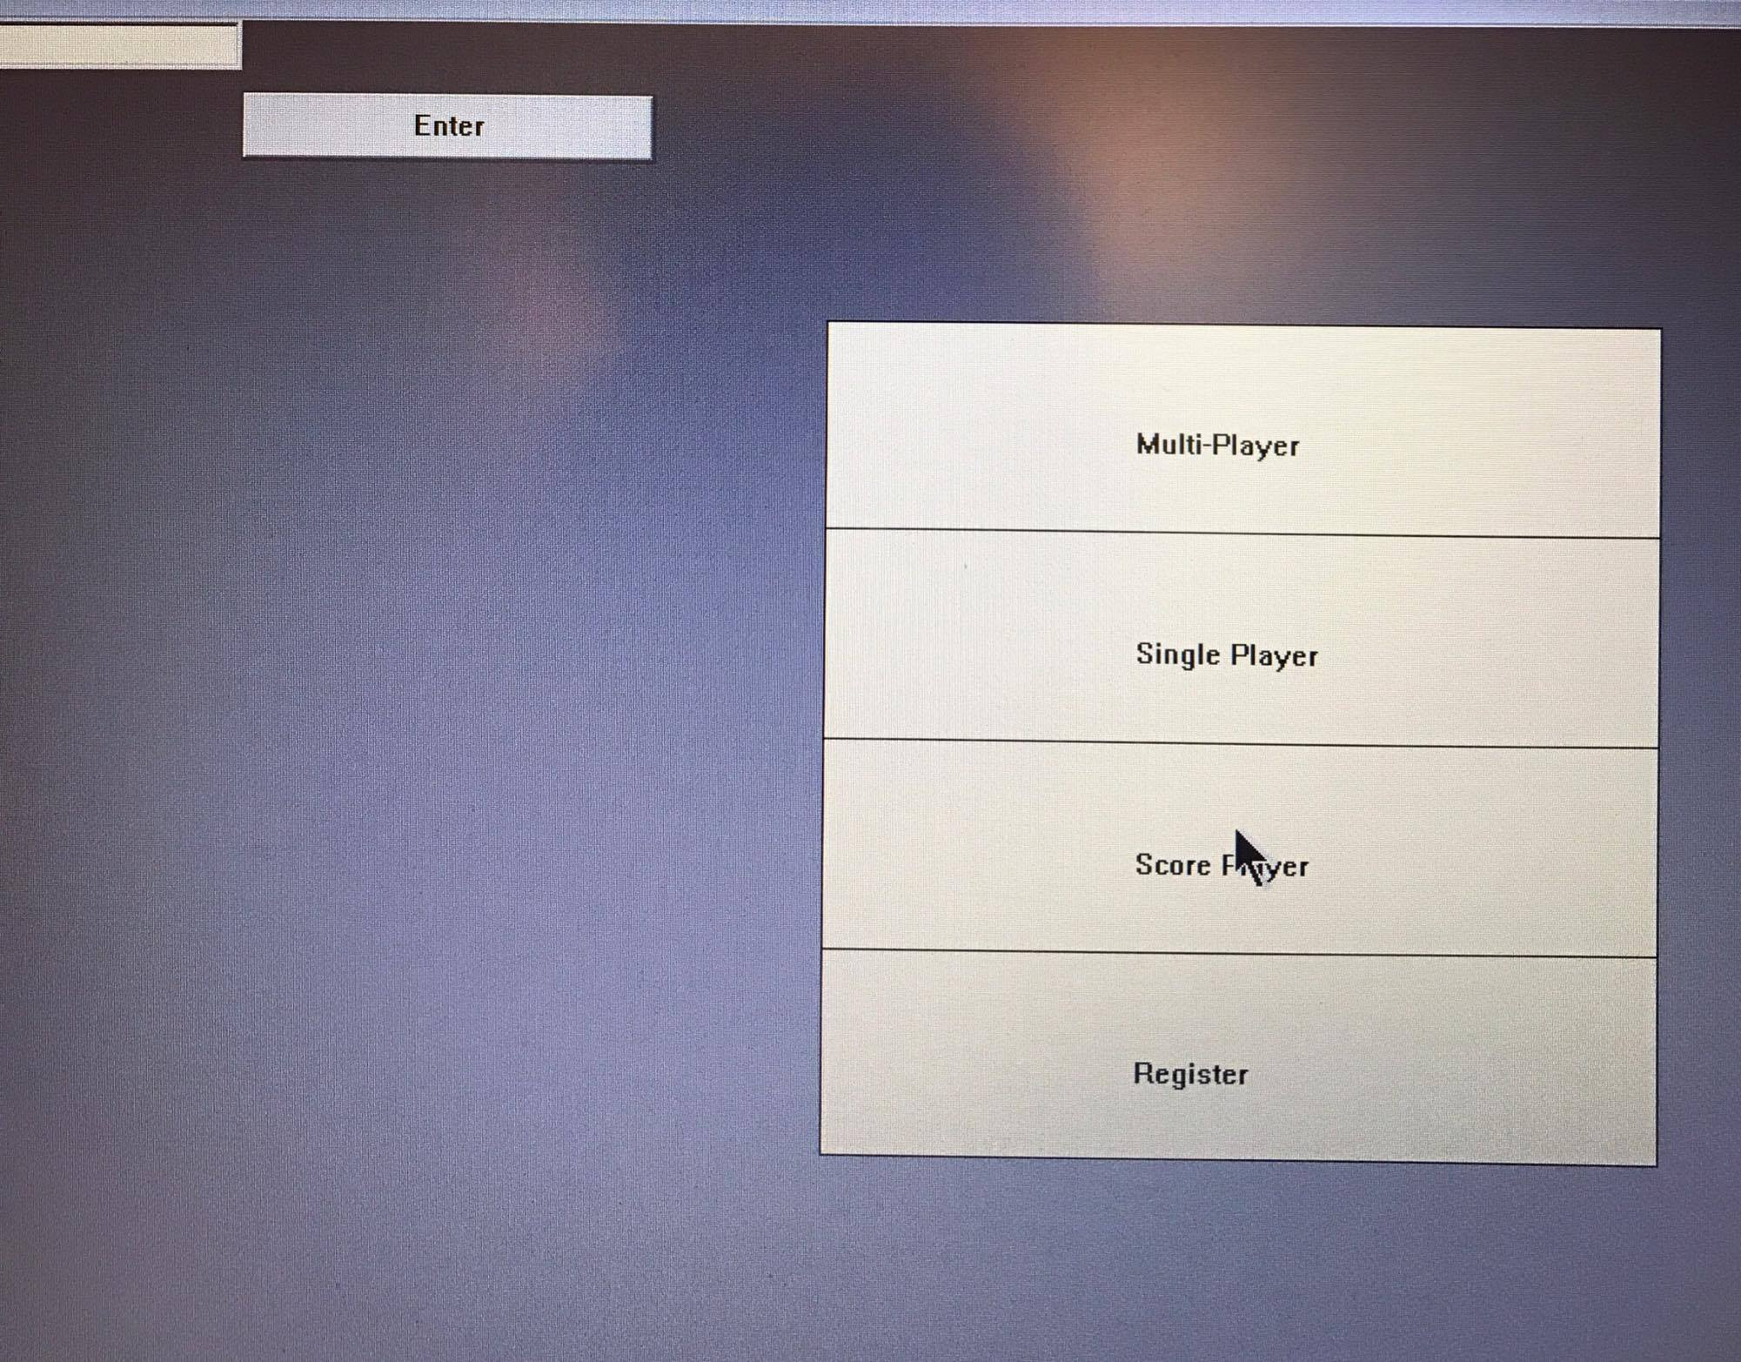

Slide 7
1.1 Objectives
The objective is to complete within budget and to fulfill the required expectations of the Tic Tac Toe software, where users can use the software to play a game of tic tac toe with another player or the AI.
This document describes the plan for testing the Tic Tac Toe software. This Test Plan document supports the following objectives:
Identify existing project information and the software that should be tested.
List the recommended test requirements.
Recommend and describe the testing strategies to be employed.
Identify the required resources and provide an estimate of the test efforts.
List the deliverable elements of the test activities

Slide 8
1.2 Testing Strategy
This Test Plan describes the integration and system tests that will be conducted on the software prototype following integration of the subsystems and source code.
The purpose of assembling the initial software prototype was to test its feasibility and performance. It is important that all system and subsystem interfaces be tested as well as system performance at this preliminary early stage. Testing of system functionality and features will be conducted on the prototype.
The interfaces between the following subsystems will be tested:
Single Player
Multiplayer
View History
Login
Database Update
Exit Game

Slide 9
1.2 Testing Strategy
The external interfaces to the following devices will be tested:
Local PCs
The most critical performance measures to test are:
Single Player Mode
Multiplayer Mode
The AI algorithm
Skill Level difficulty
Login/Signup validation
Update and retrieve database

Slide 10
1.2 Testing Strategy
TEST STRATEGY FOR LOGIN AND SIGN-UP
This module will be tested against all test cases .
Input: valid username, invalid username, repeated usernames, unique usernames.
TEST STRATEGY FOR SINGLE-PLAYER MODE
The efficiency of AI to predict correct moves will be tested.
Inputs: three stones in a row, four stones in a row, empty rows, five stones in a row, one stone in a row, two stones in a row
TEST STRATEGY FOR MULTI-PLAYER MODE
Inputs: Player inputs empty name, Player plays as a guest, player is a registered user, player goes first, player goes second.
TEST STRATEGY FOR LEVEL DIFFICULTY
Inputs: difficulty level easy, difficulty level medium, difficulty level hard
TEST STRATEGY FOR UPDATE/RETREIVE DATABSE
The reliability of the database will be tested.
Inputs: Push invalid data to database, push valid data, retrieve history for invalid users, retrieve history for valid users.

Slide 11
1.2 Testing Strategy
After the executable product is ready:
TEST UTILITY : The extent to which the product meets the user’s needs.
TEST RELIABILITY: A measure of the frequency and criticality of failure.
TEST PERFORMANCE: The extent to which space and time constraints are met.
TEST ROBUSTNESS: to develop test cases and test environments where a system's robustness can be assessed.

Slide 12
2. Test Items
Items included for the preliminary test plan are:
Integration testing: Testing a group of methods together that have been unit tested
Game Load: Main screen with options to “Start Game” or “ Instruction”.
Instruction Screen: display the instruction and the rules of the game.
Game Start: display the initial grid of size 5X5
Play: user can pick either “X” or “O” and use the mouse to positon their moves. The scoring and wining criteria should be check after each move.
Exit: the game will be closed.

Slide 13
2. Test Items
Regression testing: testing modified implementation to make sure the program still works with the new changes.
Test fixed bugs promptly.
Write a regression test for each bug fixed.
Identify tests that the program consistently passes and archive them.
Make changes (small and large) to data and find any resulting corruption.
System testing: the whole game is played by visiting all the options/screens/modules. The game should behave as per the requirements.

Slide 14
2.1 Program Modules
Log in/ Sign up
Display UI
User Options
Process Game
Process Database
Show History

Slide 15
2.3 User Procedures
All members of the team will test the final software for accuracy and to ensure its meets the client’s needs. Once final testing is completed, the user documentation will be drafted.

Slide 16
2.4 Operator Procedures
The software is being written and tested using Visual Studio to run on the Windows operating system. Once the final software is complete, running the software and debugging it in the windows operating system will ensure its compatibility.

Slide 17
3. Features to be tested
Features in the software to be tested are as follows:
Single player
Multiplayer
View history
Options
Start Game
Choose level
Music off/on
Exit Game

Slide 18
4. Approach
At this preliminary stage of testing and design. The team leader and the secretary of the team will be testing the source code and the AI algorithm for the software. This task should take at the least two weeks to three weeks.
This task will be done by using Visual Studio to run and compile the source code and to check for any errors in coding. By process of elimination, when there are no errors found, initial testing is completed.

Slide 19
4.1 Component Testing
Here each method is tested independently using Visual Studio 2015 using visual studio test suite. The complete test cases are available in separate pages.
Testing Techniques:
Statement testing: Testing to satisfy the criterion that each statement in a program is executed at least once during program testing
Block testing: testing to satisfy how many blocks have executed

Slide 20
4.2 Job Stream Testing
Start game in a designated environment. Initialize the main screen
Login Screen shows up. Validate user credential or create a new user data.
Testing “Multiple Player Mode” Or Single Player VS Computer Mode”
Testing scoring algorithm, wining Algorithm and AI algorithm.
Update user’s data information.
User chooses to keep playing or quitting the game.

Slide 21
4.3 Interface Testing
Team member will be playing the actual games to monitor and compare the actual and expected output.
4.4 Security Testing
The security testing is performing to check whether user can login with existed credential.

Slide 22
5. Pass / Fail Criteria
Every primary use case must be successful for the application to pass. If any test associated with a primary use case fails, the system test fails.
5.1 Suspension Criteria
Tests will be sequenced to exercise progressively more of the system. Testing will be suspended when program faults prevent the tester from moving further into the system.
5.2 Resumption Criteria
After analyzing the source of errors and corrected fixes have been carried out; testing will be resumed.

Slide 23
6. Environmental Requirements
The environmental requirements needed to design the software are:
Personal Computer.
Designing environment (Visual Studio)
Communication tools (Emails, Meetings, Calls, Github)

Slide 24
7.Hardware
The hardware needed to test the program is as follows:
Processor : Intel® Core™ i5-4700MQ CPU @ 2.00 GHZ
RAM: 1.00 GB or Higher
System Type: 32- bit or higher Operating System , x86-based processor or higher.

Slide 25
7.2 Software
The software needed to test the program is as follows:
Windows Operating System – Win XP /vista/7/8.0 or higher
7.3 Security
No security is needed for the testing environment.
7.4 Tools
The tools used to test the software will be Visual Studio.

